Slide 1

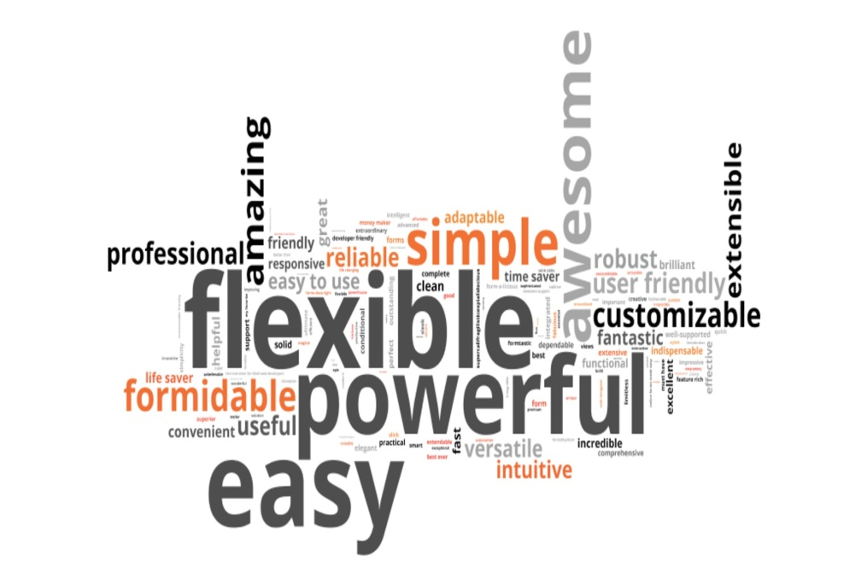
Topic Modeling & Sentiment Analysis using NLP
How Topic Modeling and Sentiment Analysis can Improve Your Business?

Slide 2
“Understanding what is possible using NLP and how to build Topic Modeling & Sentiment Analysis“
“NLP serves your business by increasing productivity”
nlmtd 08-11-26

Slide 3
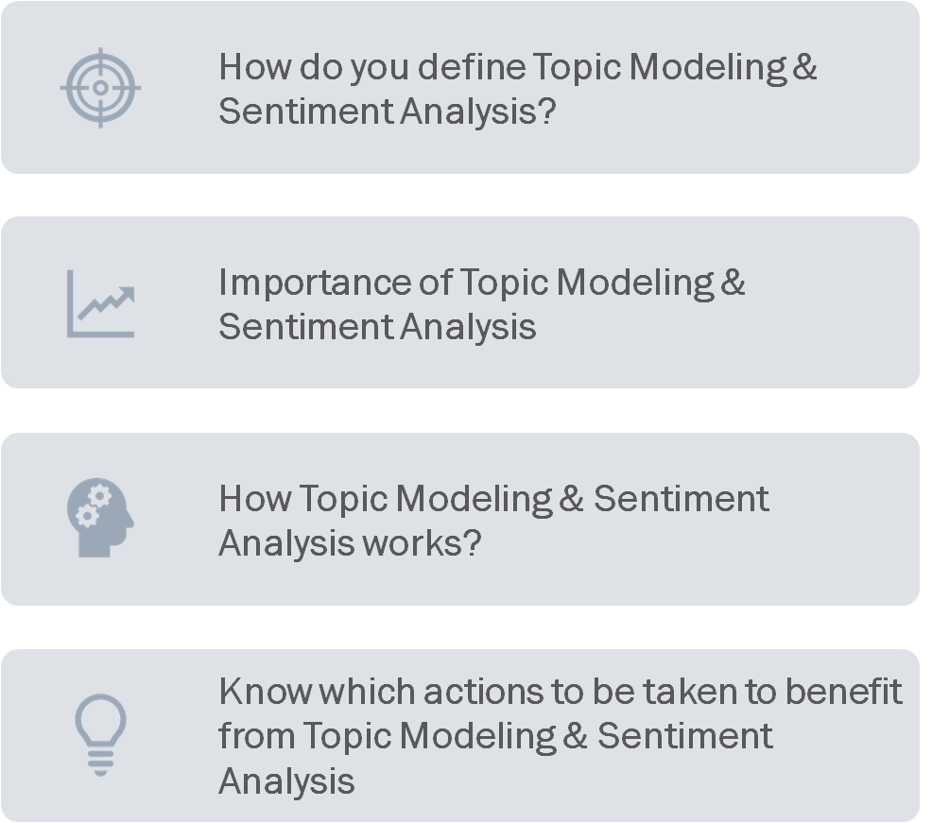
Introduction

Slide 4

How do you define Topic Modeling?
Topic Modeling is an unsupervised learning used to discover the hidden semantic structure in a given corpus using NLP techniques.
Example: The words "dog" and "bone" will appear more often in documents about dogs, "cat" and "meow" will appear in documents about cats, and "the" and "is" will appear approximately equally in both.
Introduction

Slide 5
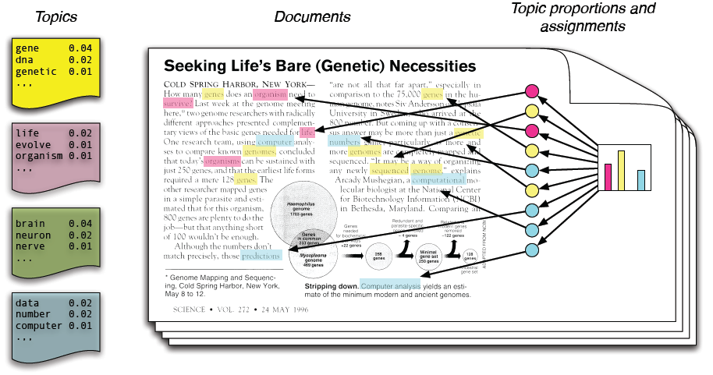
Topic Modeling

Slide 6
How do you define Sentiment Analysis?
Sentiment Analysis is the process of computationally identifying and categorizing opinions expressed in a given text, especially in order to determine whether the writer's attitude towards a particular topic, product, etc. is positive, negative, or neutral.
Example: Companies use sentiment analysis to determine the opinion expressed by their customers without reading the contents and prioritize the customer support activities.
Introduction

Slide 7
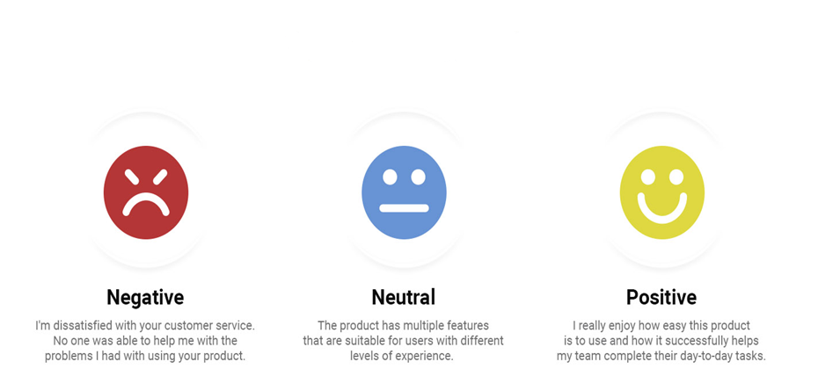
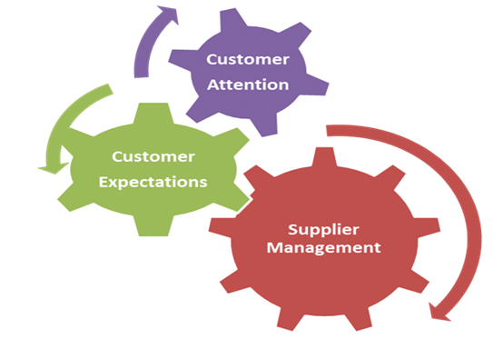
Sentiment Analysis

Slide 8
Importance
A Good Topic Model bring better visibility on customer complaints
A Good Sentiment Analysis improves productivity
A Good Sentiment Analysis is a better classifier on customer complaints

Slide 9
How Topic Modeling works?
User defines the number of “K” topics
User defines the number of words per topic
Probabilistic approach to analyze “bags” or groups of words together
Possible Outcome
  Identifies words that are most frequently associated with each of the k topics specified by the user
  Gives the probability that each document within the corpus is associated with each of the k topics specified by the user
Notes:
https://cbail.github.io/SICSS_Topic_Modeling.html

Slide 10
How Sentiment Analysis works?
Identify the languages
Split sentences into words or Tokens
Remove stop words, articles, plurals, tenses
Machine learning or Lexicon based approach to identify sentiments
Possible outcome
  Email classification in case of supervised learning on customized Business needs
  Email sentiment identification in case of unsupervised learning
Notes:
https://www.brandwatch.com/blog/understanding-sentiment-analysis/#:~:text=Sentiment%20analysis%20%E2%80%93%20otherwise%20known%20as,expressed%20within%20an%20online%20mention.

Slide 11
NLP Architecture
Topic Modeling & Sentiment Analysis Use Case:
  Customer support Emails
    Sentiment Analysis
    Topic Modeling
    Email classification
Data Exploration
Sentence Splitting
Tokenizing
Stop word removal
Word Count
Analysis

Slide 12
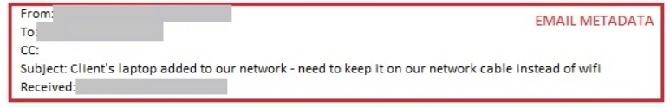
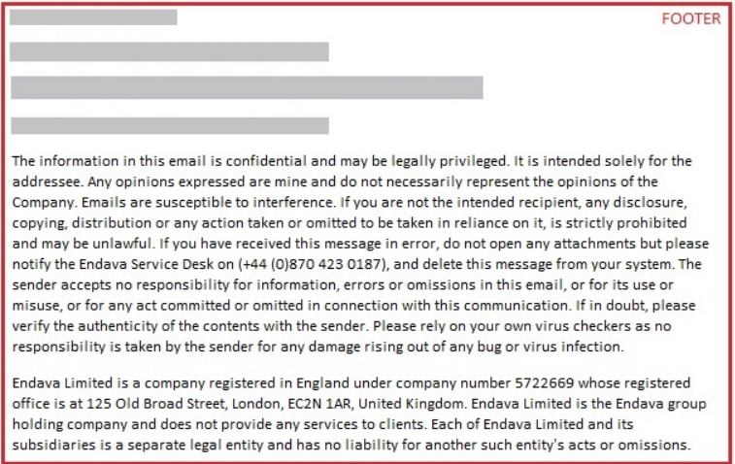
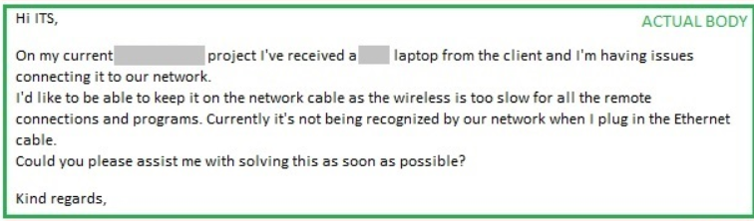
Data Exploration

Slide 13
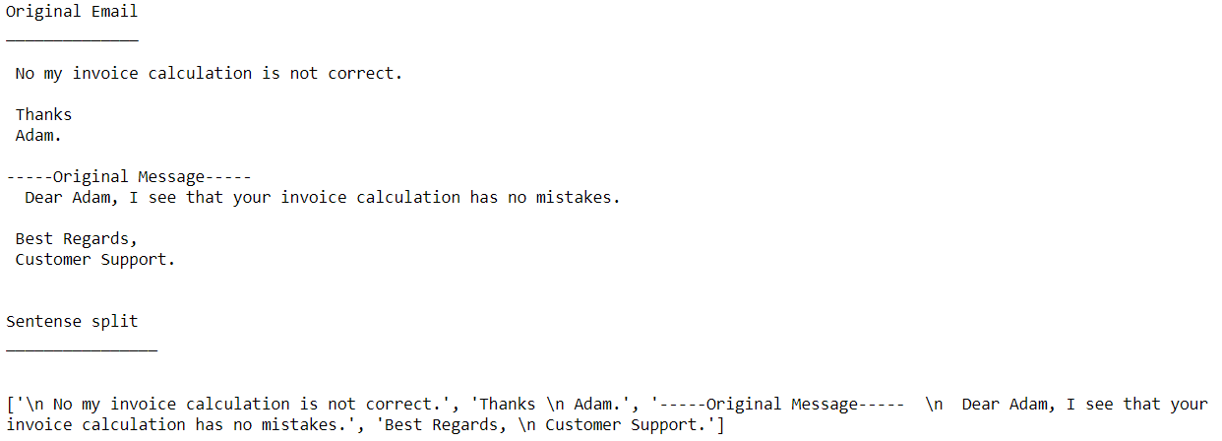
Sentense Spliting

Slide 14
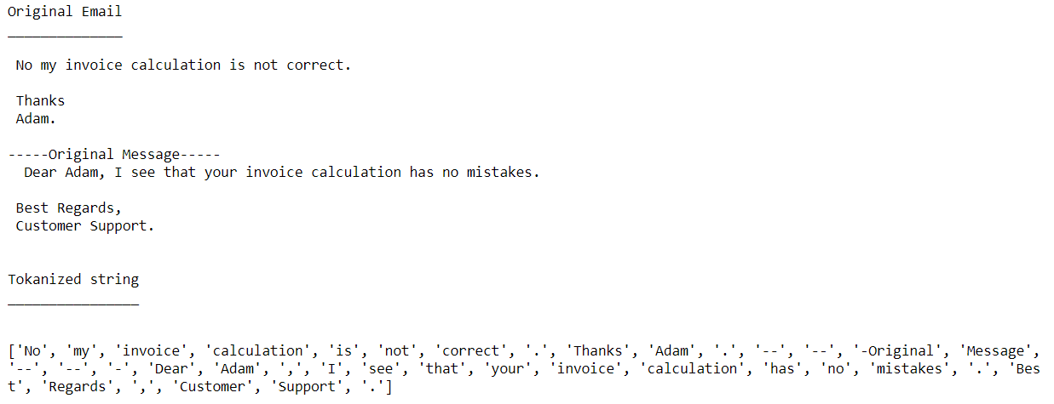
Tokanization

Slide 15
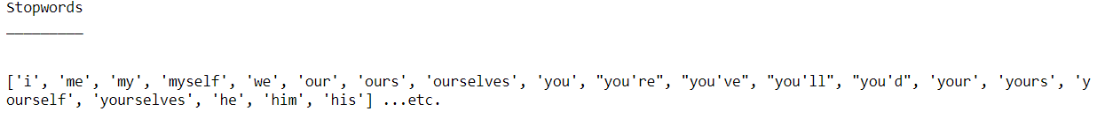
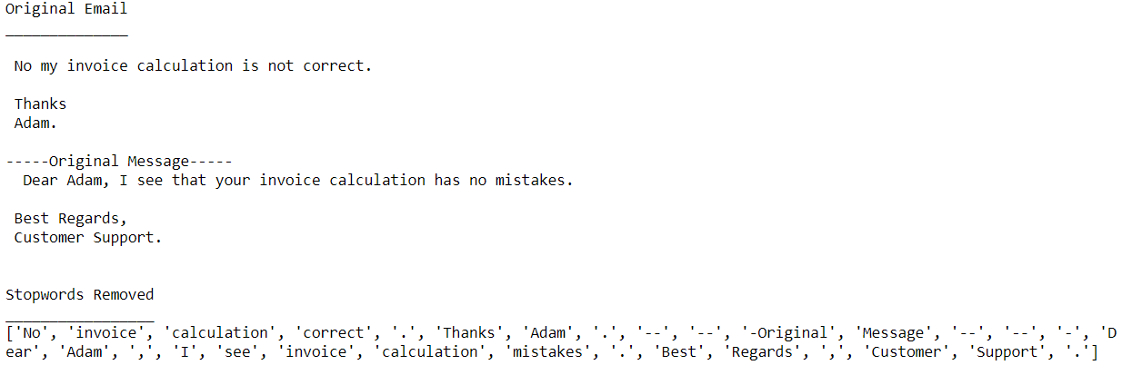
Stopword Removal

Slide 16
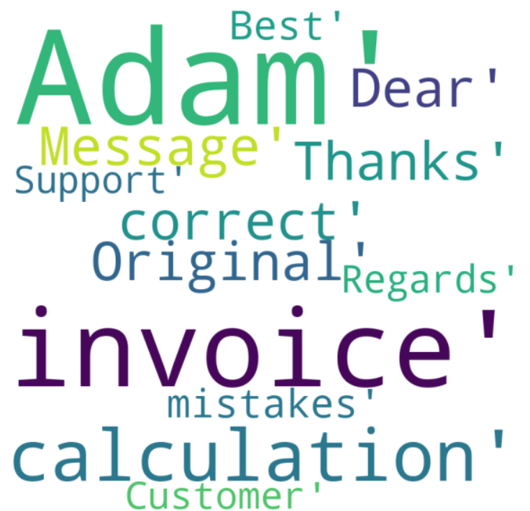
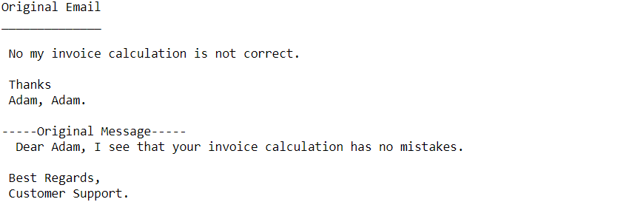
Word Cloud

Slide 17
Sentiment Analysis

Slide 18
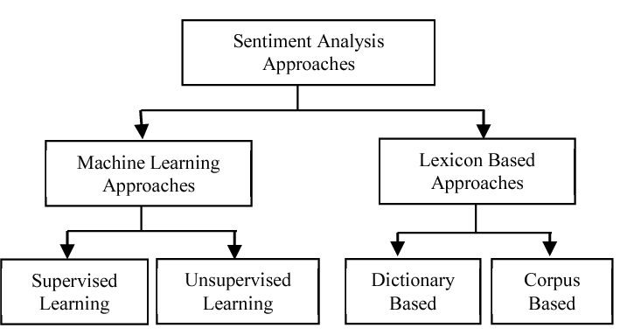
Sentiment Analysis

Slide 19
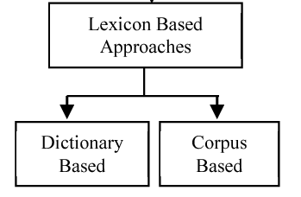
Sentiment Analysis
Dictionary Based- Using predefined sentiment dictionaries from tokens
Example: TextBlob, Vader
Corpus Based- Build specialized sentiment dictionaries from the corpus of text.

Slide 20
Dictionary Based Sentiment Analysis on Emails

Slide 21
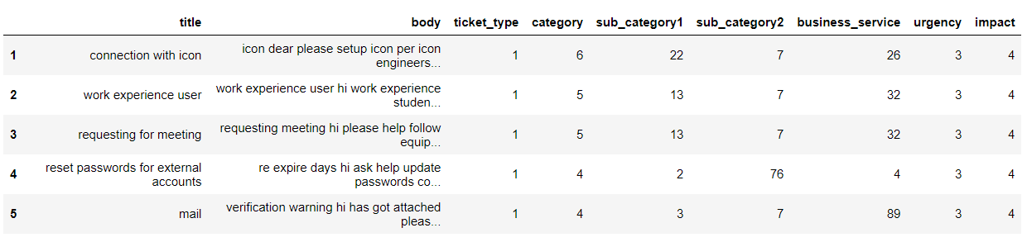
Dataset

Slide 22
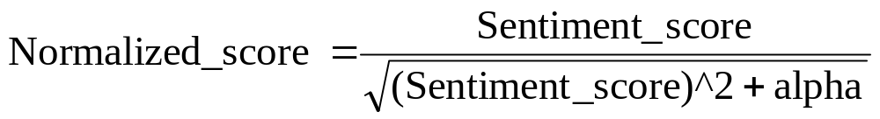
Vader- Sentiment Analysis
Tokens | Sentiment Score
zealots | -0.8
zealous | 0.5
{: | 1.8
|-0 | -1.2
|-: | -0.8
|-:> | -1.6
|-o | -0.9
}:-) | 0.3

Slide 23
Vader- Sentiment Analysis

Slide 24
Topic Modelling

Slide 25
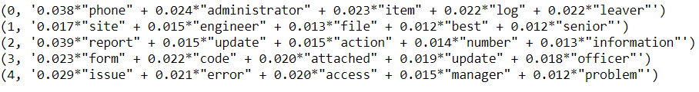
Topic Modelling
1.
2. Onsite
3. Existing issue
4. Contact form related
5. Access issue

Slide 26
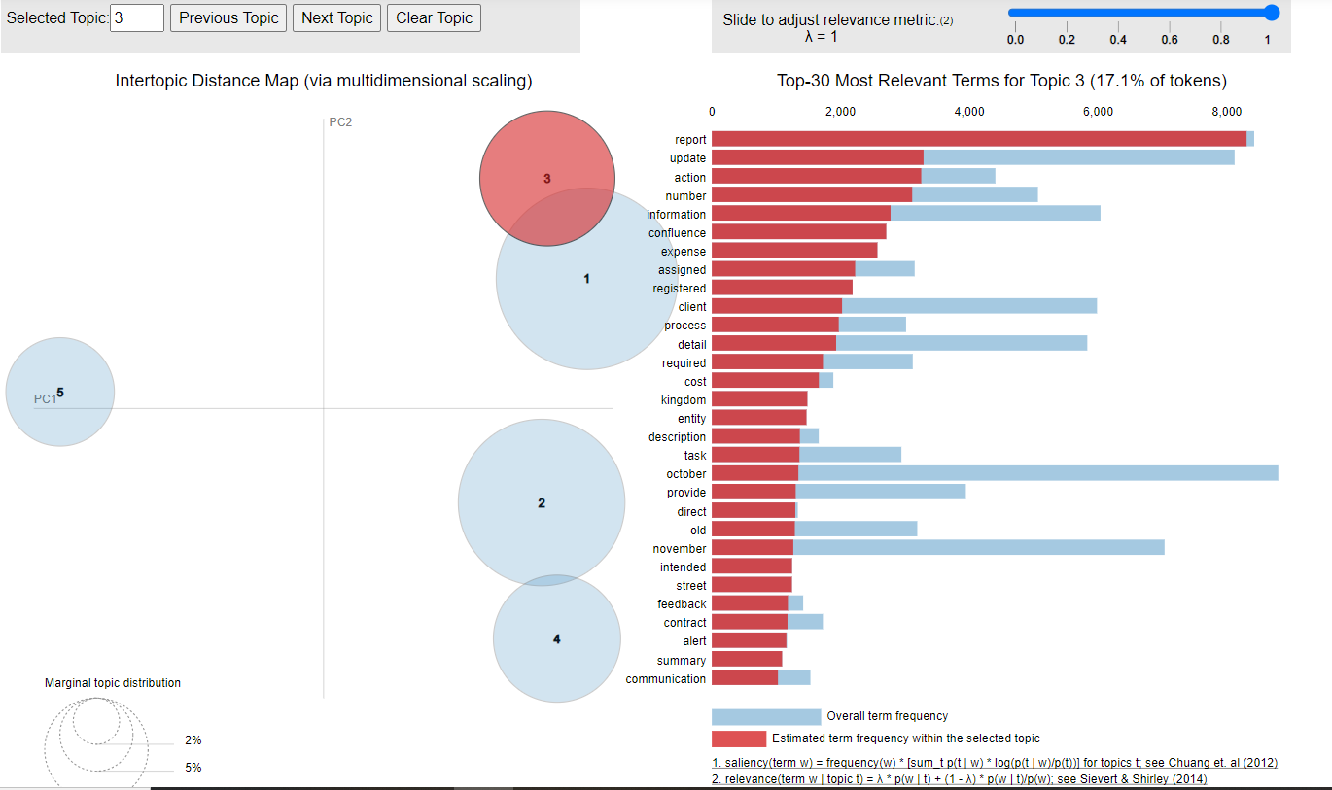
Topic Modelling

Slide 27
Email Classification- Supervised learning

Slide 28
Supervised Learning-
Email Classification

Slide 29
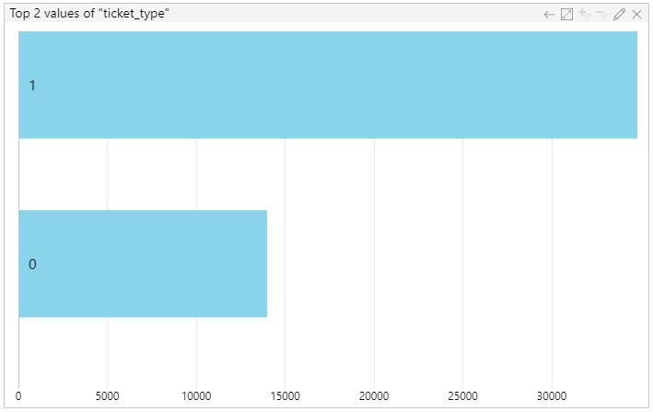
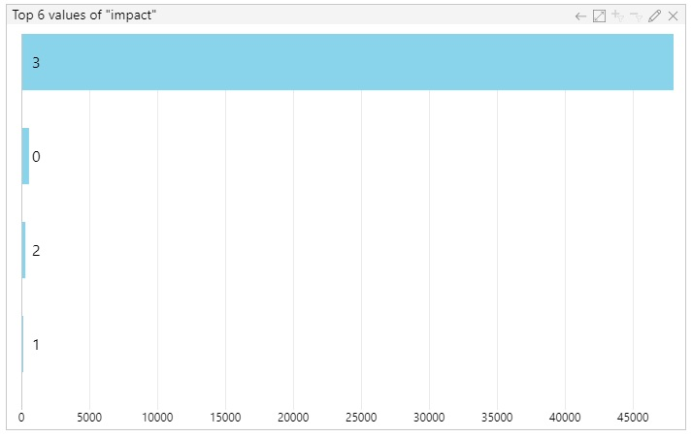
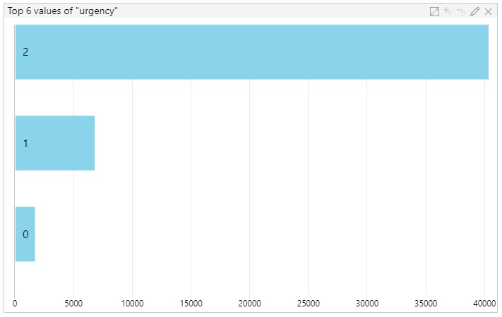
Email Classification
Ticket Type
Impact
Urgency

Slide 30
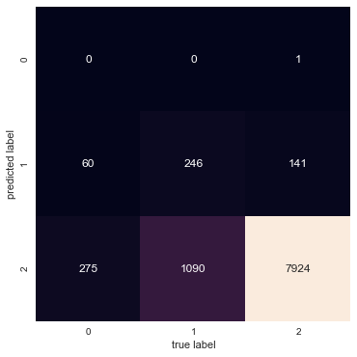
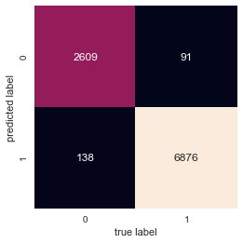
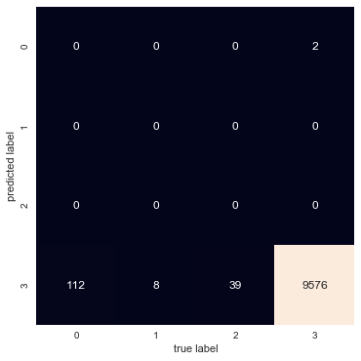
Email Classification
Ticket Type
Impact
Urgency

Slide 31
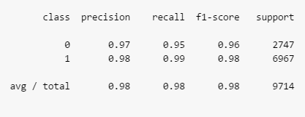
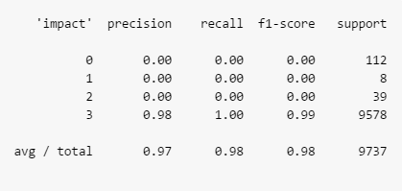
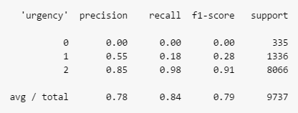
Email Classification
Ticket Type
Impact
Urgency

Slide 32
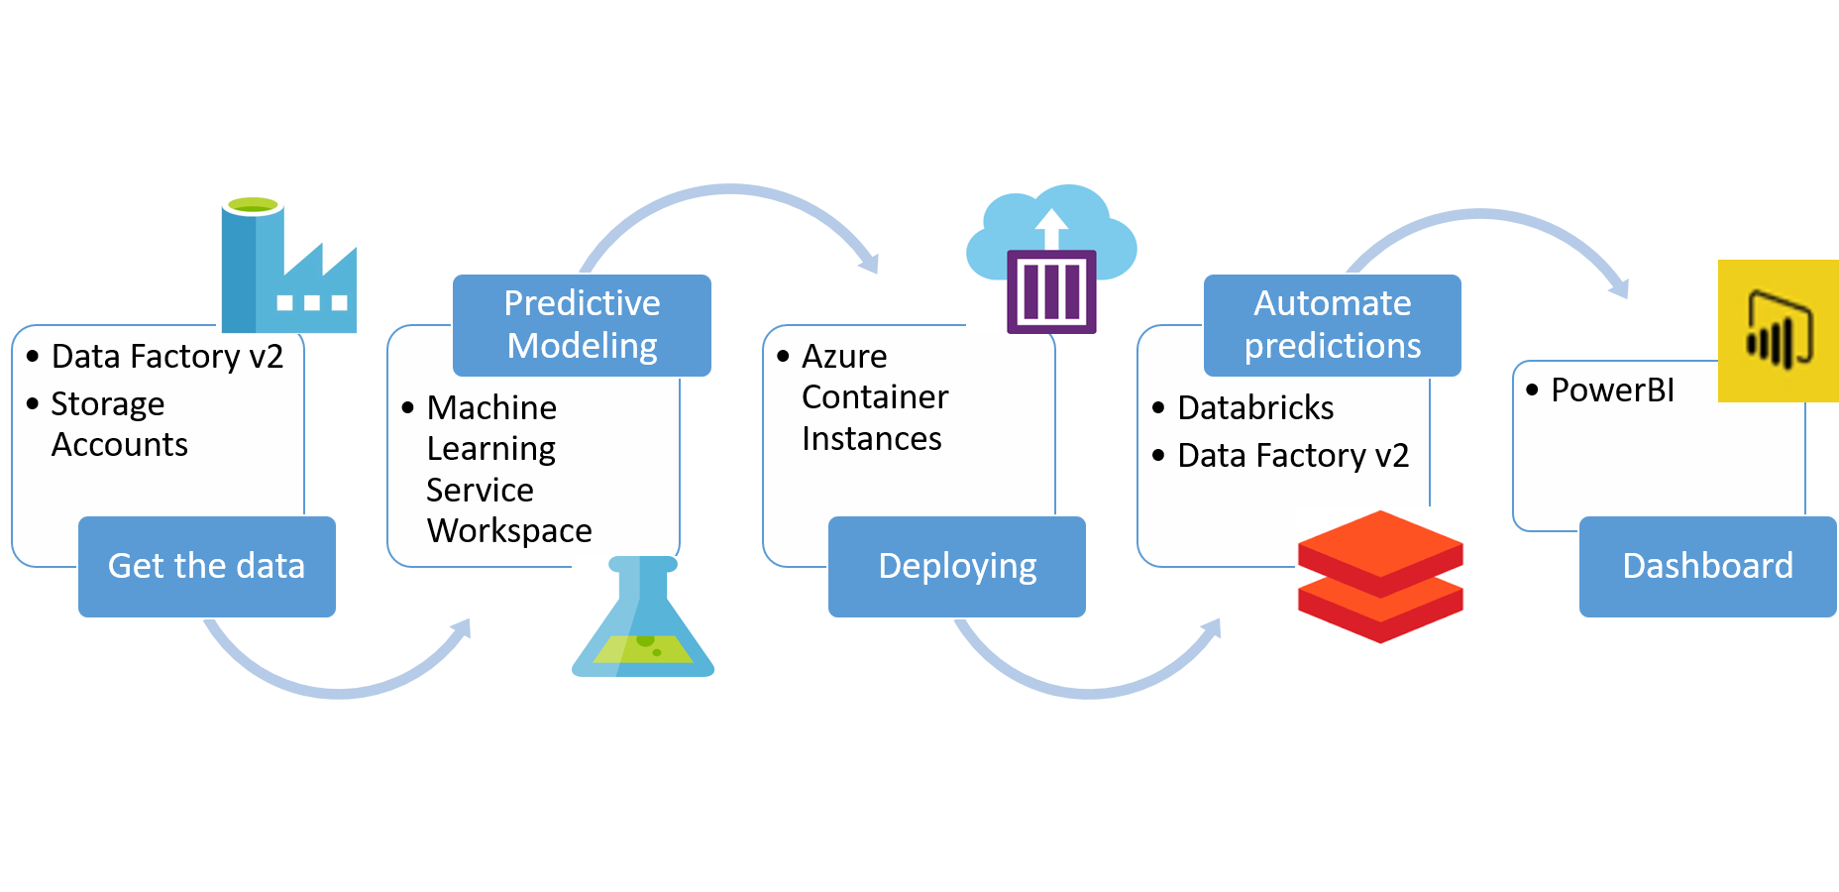
Deployment using Azure

